Slide 1
How to buy best buy apartment in Zagreb
By: Natan Bonašin

Slide 2
- There is huge demand for apartments, therefore prices are soaring
- sellers would like to sell their real estates fast, while buyers want to find fast place to live.
- In order to accomodate both its good to understand what is driving the price up or down
- for those who sell they can adjust their price so asset can be sold faster, or if undervalueted if could be adjusted.
- for those who buy they want to understand where to focus time to find appropriate real estate which is within their budget.

Slide 3
DANA acqusition and cleaning
As there is no geodata.json of zagreb districts to visualise it had to be created json file with geo boundaries of each district to visualise actual situation.
To have a glipmse on situation on market i have scraped small sample from njuskalo.hr
For some general info on each districts i have used dana from wikipedia.

Slide 4
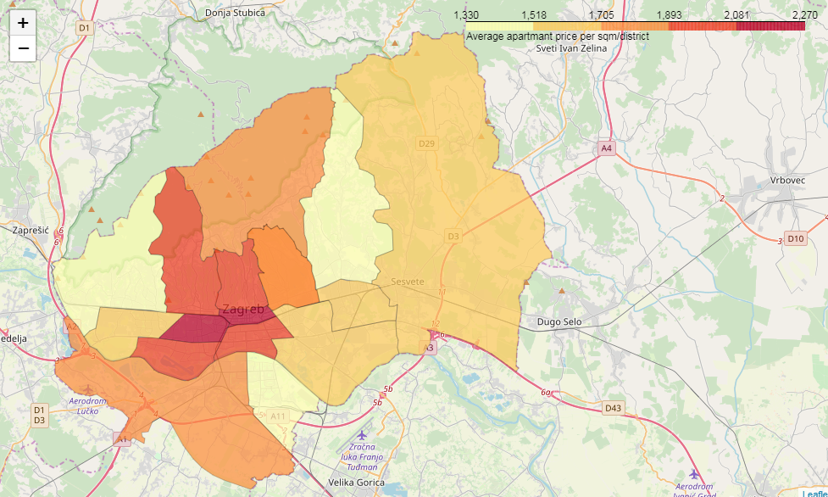

Slide 5
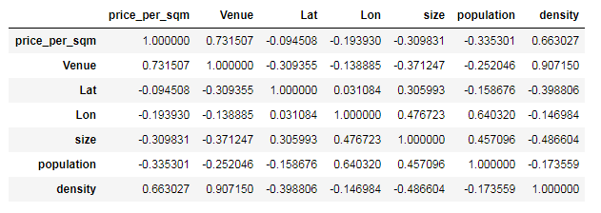
From previous slide we could see actual situation as per average price per each district which helps to focus on districts which are within the budget.
Second best option is to check correlation between all features which were collected

Slide 6
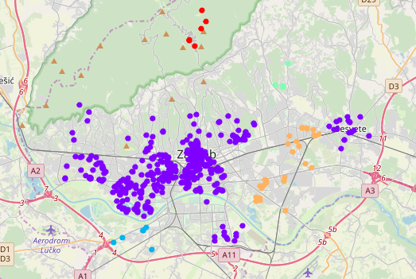
K-means cluestring didn’t provide any valuable output, perhaps i wa slooking too wide or this method is not the most appropriate for this job and datasets, as it can be seens from below visaulisation.

Slide 7
CONCLUSION AND NEXT STEPS
More dana is needed to trully understand what is driving prices of real estates in Zagreb so high
More granular analysis could be usefull, perhaps more algorithms couls be evaluated to see which would fit the best.
This analysis still has manged to provide some basic idea where to look if you want to buy cheap apartment in Zagreb.

